Slide 1
Current Trends in Information Technology
Chapter ?

Slide 2
What’s happening around us?
If you want to be ahead of the competition, you will need to know the latest trends and events occurring within your industry.
However, having a good knowledge of your industry is not enough as there is one key external factor that is important and will dictate the direction of the industry – the IT sector.

Slide 3
ICT as Change Agent
The Information Technology Association of America defines IT as the study, development, designs, implementation, support, and management of information systems that are computer based.
Today, IT has become a huge agent of change in different business aspects of the society. It is a game changer when it comes to the resolving of social and economic issues. Some of the major trends in the IT sector are obvious.

Slide 4
The Internet of Things (IoT)
Industry experts say that while the Internet of Things (IoT) had a false start particularly in regard to the augmented technology, in 2018, we should expect to see it improve our ways of doing things at home, work and even during leisure activities. This is why we expect to see it be among the biggest IT trends of 2018. The IoT is usually driven by the industry and will succeed the most if it focuses on getting solutions for some specified problems. The industry focuses on firmware and software that is hardware centric and suits those who love creating solutions and meets the demands of the engineering field.

Slide 5
IoT
The Internet of Things is a system of interrelated computing devices, mechanical and digital machines, objects, animals or people that are provided with unique identifiers and the ability to transfer data over a network without requiring human-to-human or human-to-computer interaction. (Wikipedia)

Slide 6
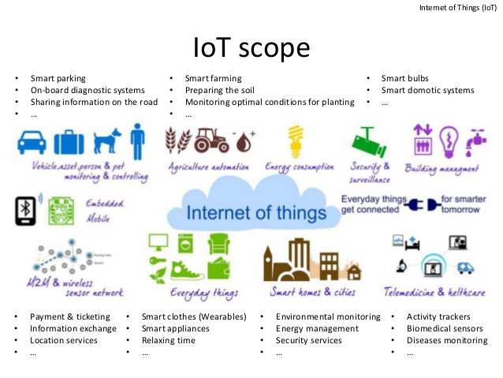

Slide 7
Big data
The technologies that are related to the big data will continue rising in importance in 2018. Due to its great return on investment, impact speed and measurability, digital marketing are now more popular as compared to the traditional marketing.
This means that big data is now applied to the big business as many of the digital marketing campaigns can rely on the huge data quantities to ensure effectiveness and a greater reach. This is why companies are now relying on the data management to ensure conversions from online connections.

Slide 8
Artificial intelligence
According to a leading essay writing service, Artificial intelligence (AI) is definitely among the biggest hits when it comes to IT trends that has impacted creativity in the online space. AI can be manifested through different algorithms for machine learning.
This can be manifested not only in the amount of funding that AI receives but also the wide range of applications where it is being incorporated. Instead of focusing on a single goal such as communicating with humans or mastering a certain game, AI has now started to get into new platforms, device or app and we will continue to see this trend accelerating in the future. This is why AI is a trend that will affect human resources development.

Slide 9
Cloud computing
A key IT concept that is commonly talked about is cloud computing. This involves the use of computer services like hardware and software over the internet.
There are 3 various benefits of cloud computing. These include: – Minimizing the cost of IT infrastructure to a company – Promoting the virtualization concept which can enable storage devices and servers to be used across different organizations – It makes it easier to maintain hardware and software and there is no need for installation on each of the end-users computers.
However, there are also certain concerns regarding cloud computing such as compliance, IT governance, privacy, legal abuse and many more.

Slide 10
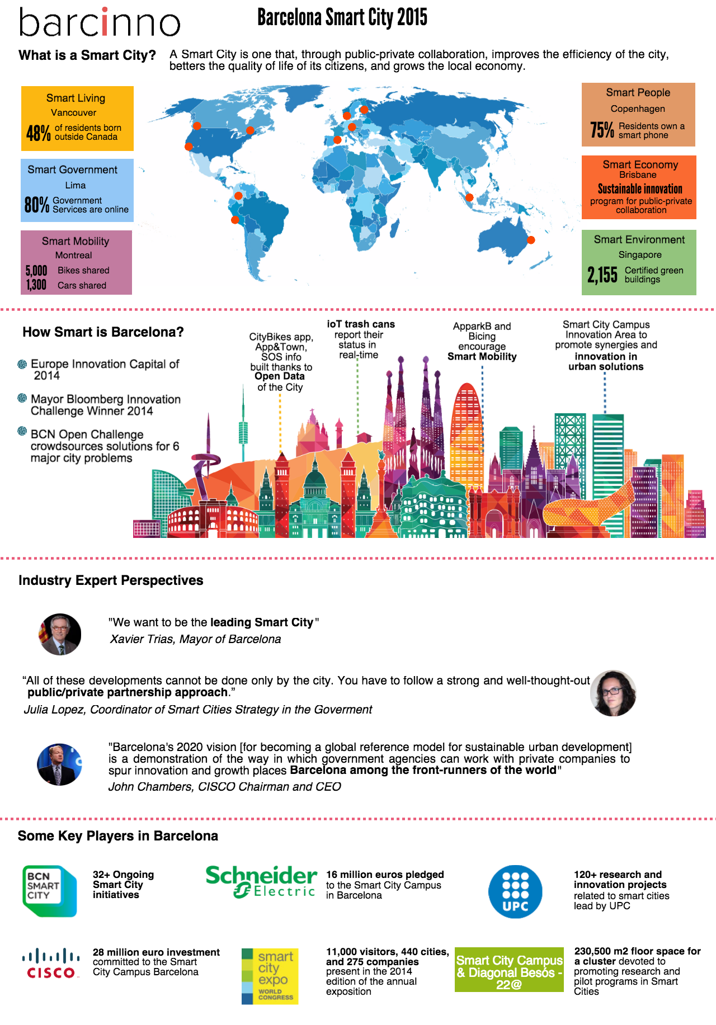

Slide 11
User interface
The user interface is one area that has undergone massive revolution since the touch screen was introduced. The capability of the touchscreen has revolutionized how the end users are able to interact with the application.
With the touch screen capability, the way users are able to interact with the application. Users are now able to interact freely with what is being displayed without the need for an intermediate device such as a mouse.

Slide 12
Mobile application
The mobile application is another trend that has become popular in the recent past. Mobile apps are designed to run on mobile devices such as tablets and smart phones.
These can be downloaded from different devices in operating systems such as Blackberry, Apple, Nokia etc. Some of these are available for free while others come at a cost. Any revenue collected is usually between the app developer and distributor.

Slide 13
Mobile web performance
A website that hasn’t been optimized for the mobile devices is now getting penalized by the search engines. Nowadays, more users are expecting a better online performance from mobile devices.
This has resulted in a race for the improvement of the mobile performance. This means that the 2018 web trends will include user-triggered animations, mobile-only development, secured apps and pages and natural language processing. There will also be an increased usage of white or negative spaces.

Slide 14
5G Proliferation
Among the main IT trends 2019, there is the long-awaited launch of 5G. The networks of the new generation have been already testing throughout 2018, and in the coming year, the first 5Gready smartphones will be released.

